Slide 1
<number>
An Efficient Multiplication Algorithm using Urdhava Tiryakbhyam (Vedic Math)
14/11/2019
MENTOR
DR. P.K KEWAT
NISHANT BHASKAR
ADM. NO 16JE002260

Slide 2
<number>
Abstract
Multiplication is the essential and abundant part of DSP applications. There are different types of multiplication technique are used to perform various applications. ex-Array multipliers. The speed of multiplication is improved by Vedic Multiplication Technique so that it can be used in very complex multiplication based systems.ex-RSA,ECC etc. RSA algorithm is one such popular algorithm which is used for security of networks. It includes several time consuming exponentiation operations based on multiplications. Therefore the proposed algorithm for multiplication based on Urdhva Tiryagbhyam Sutra is applied to RSA to enhance the speed of operation.
Keywords: Cipher text, Modular exponentiation, RSA algorithm, Urdhva tiryagbhyam sutra, Vedic multiplier
14/11/2019

Slide 3
<number>
INTRODUCTION
Multiplication technique plays an important role in today’s digital signal processing and various other applications. The implementation efficiency and performance of systems are dependent on the efficiency of the multiplication. Array multiplier and Vedic multiplier are the different types of multipliers. The array multiplier is a normal multiplier which is based on the shifting and adding operations while Vedic multiplier is based on the natural principles on which human mind works.
14/11/2019

Slide 4
<number>
INTRODUCTION
Vedic multiplier is based on Indian Vedic Mathematics. The Sanskrit word “Veda” means “Knowledge” and it consists of large number of documents. Vedic Mathematics is the name given by Sri Bharati Krishna Tirtha Maharaj. He explained about 16 Sutras in Vedic Mathematics. The proposed multiplier uses Urdhva tiryagbhyam Sutra, which is a simple multiplication formula which literally means “Vertical and Crosswise”. The advantage of using Vedic multiplier is that the partial products are calculated in a single step and there are no time consuming shifting and adding operations.
14/11/2019

Slide 5
INTRODUCTION
The application of the high speed multiplier mainly includes the cryptographic systems. Cryptography is the science of using mathematical equations for encryption and decryption of data. By using this technique, the information cannot be read by unintended recipients. Public key cryptography and private key cryptography are the two kinds of cryptographic techniques. Public key cryptography system is a well-known method which is used in many applications such as smart cards, digital certificates etc.

Slide 6
<number>
INTRODUCTION
RSA (Rivest Shamir Adleman algorithm) is one of the widely used public key algorithms developed in 1977 by Ron Rivest, Adi Shamir and Len Adleman. It is one of the simplest and safest algorithms that use different keys for encryption and decryption. The most time consuming operation in RSA algorithm is modular exponentiation operations that include several modular multiplication operations. This algorithm is used here to speed up the operation thus the overall system provides an efficient technique for enhancing security in networks.
14/11/2019

Slide 7
<number>
Urdhava Tiryakbhyam
Urdhava Tiryakbhyam Sutra, which literally means “Vertically and crosswise”, is a general multiplication formula applicable to all cases of multiplication. This Sutra highlights parallelism in generation of partial products and their summation as depicted in Fig 1. Consider multiplication of 576x324=186624.
14/11/2019

Slide 8
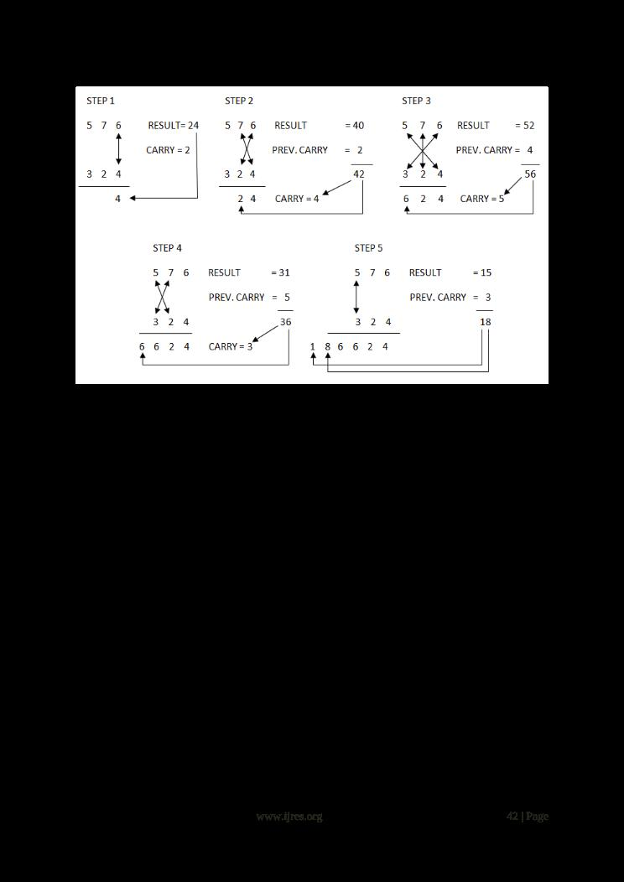
<number>
Urdhava Tiryakbhyam
Fig: 1 Illustration of vertically and crosswise multiplication
14/11/2019

Slide 9
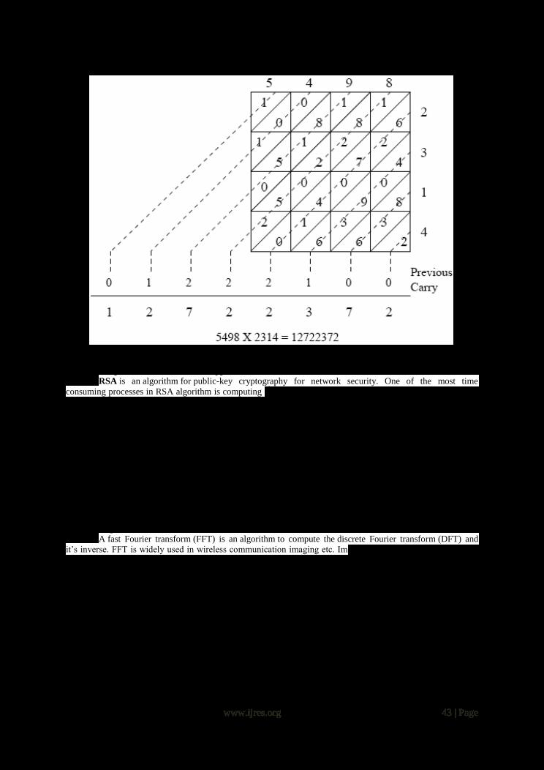
<number>
Urdhava Tiryakbhyam
14/11/2019
Fig 2: Alternative way of multiplication by Urdhva tiryakbhyam Sutra

Slide 10
Implementation of RSA encryption
RSA is an algorithm for public-key cryptography for network security. One of the most time consuming processes in RSA algorithm is computing a^{b} mod n where ‘a’ is the text and (b, n) is the public key. Dhvanjanka sutra is used in RSA encryption and decryption algorithm. RSA implemented using the overlay hierarchical multiplier architecture and division architecture using Dhvajanka sutra of Vedic mathematics reduces computation time and reduces delay greatly as compared to the RSA implemented using traditional multipliers and division algorithms.

Slide 11
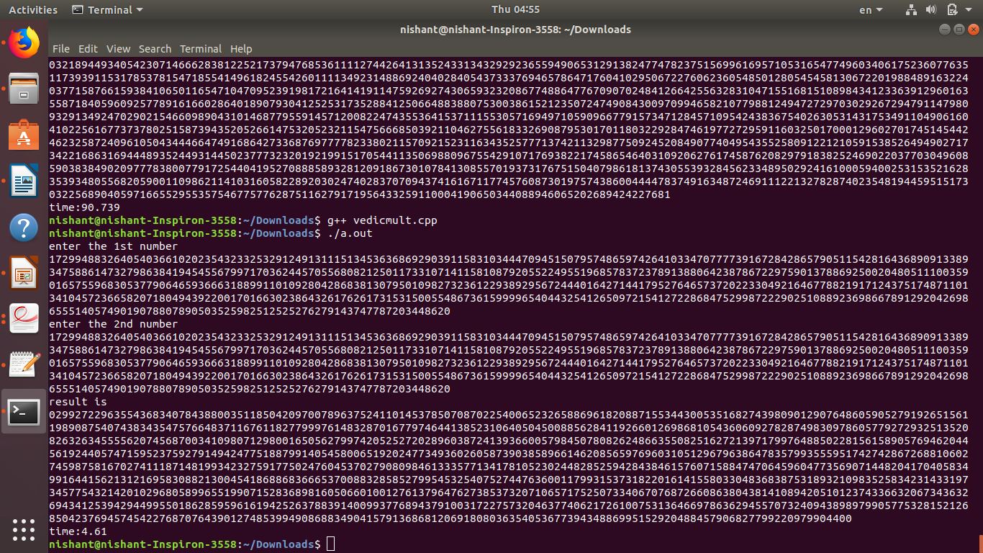
<number>
OUTPUT(VEDIC MULTI)
14/11/2019

Slide 12
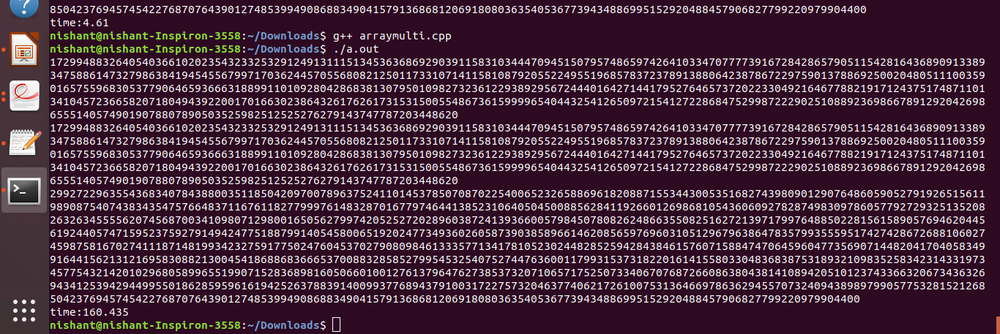
<number>
OUTPUT(ARRAY MULTI)
14/11/2019

Slide 13
<number>
RESULTS AND CONCLUSION
The multiplication in RSA algorithm is very critical operation. This calls for the need for a fast multiplication. The array multiplication and Vedic multiplication are implemented, the time were analyzed and it is found that Vedic multiplication performs faster than others. The Execution Time analysis is shown in table 1 .
14/11/2019

Slide 14
RESULTS AND CONCLUSION
<number>
14/11/2019
No of digits | Digit 1-20 | Digits =500 | Digits =5000
Time in array multiplication(ms) | 0.46 | 54.265 | 17622.6
Time in Vedic multiplication(ms) | 0.11 | 1.885 | 92.346

Slide 15
<number>
REFERENCE
KRISHNA TIRTHA BHARTI.1965.vedic mathematics . 8th edition. Delhi : Motilal Banarasi das publisher private limited.
Sushanta Kumar Sahu , Manoranjan Pradhan, “FPGA Implementation of RSA Encryption System”, International Journal of Computer Applications (0975 –8887)Volume 19– No.9, April 2011.
14/11/2019

Slide 16
REFERENCE
Cryptosystem Using Verilog”, International Journal of Scientific & Engineering Research, Volume 2, Issue 5, May-2011 1 ISSN 2229-551
Shahina M. Salim1, Sonal A. Lakhotiya, “Implementation of RSA Cryptosystem Using Ancient Indian Vedic mathematics”, International Journal of Science and Research (IJSR) ISSN (Online): 2319-7064 Index Copernicus Value (2013): 6.14 | Impact Factor (2013): 4.438
G.Suman , P.Anuradha, “RSA Algorithm and LSB Steganography”, International Journal of Engineering Research & Technology (IJERT) Vol. 2 Issue 10,
October – 2013 ISSN: 2278-0181.

Slide 17
<number>
Thank you
14/11/2019

